Slide 1
Smart Solar farm: Integrating IoT for Adaptive Solar Light Tracking
Rohith R | Kaushik Hariharan | Mohammed Abdullah
2023246038 | 20232176027 | 2023176026
M. Tech (IT) | M. Tech (IT) (AI&DS) | M. Tech (IT) (AI&DS)
Rohith R, Kaushik Hariharan, Mohammed Abdullah
2023246038, 20232176027, 2023176026
M. Tech (IT), M. Tech (IT) (AI&DS), M. Tech (IT) (AI&DS)

Slide 2
Abstract:
The integration of Internet of Things (IoT) technology into solar light tracking systems presents a promising avenue for enhancing energy efficiency and sustainability in various applications. This paper explores the development and implementation of a novel IoT-enabled solar light tracking system, termed "Smart solar farm." Leveraging IoT sensors and actuators, Smart Sunlight dynamically adjusts the orientation of solar panels to optimize light capture throughout the day, maximizing energy generation potential.

Slide 3
Literature Survey-1 :A photovoltaic solar tracking system with bidirectional sliding axle for building integration
Author | Published Year | Proposed Method | Future Work
Jifeng Songa,*, Yong Zhub, Dancheng Xiab, Yongping Yangb | 2015 | This paper introduces a novel single-axis solar tracking device designed to enhance energy capture, stability, and safety, particularly in windy conditions. The device features the ability to lift and lower photovoltaic panels for precise height adjustments, as well as east-west tilting to track the sun's path throughout the day, maximizing solar energy absorption. In windy weather, a stent mechanism minimizes frontal area by positioning panels near a horizontal rail, reducing wind resistance. With superior mechanical strength compared to traditional systems, the device ensures enhanced wind resistance and safety, making it suitable for PV power plants on building roofs.. | Exploring opportunities for further optimization of the system design to enhance its efficiency, reliability, and cost-effectiveness. By integrating ML and DL techniques, the developed photovoltaic solar tracking system can become more intelligent, efficient, and resilient, further enhancing its suitability for building integration and increasing its potential for widespread adoption in renewable energy applications.

Slide 4
Literature Survey-2 :Monthly profile analysis based on a two-axis solar tracker proposal for photovoltaic panels
Author | Published Year | Proposed Method | Future Work
Fabio Moacir Hoffmann, Rolf Fredi Molz, Jo~ao Victor Kothe, Elpidio Oscar Benitez Nara*, Leonel Pablo Carvalho Tedesco | 2018 | The proposed method involves developing and evaluating a two-axis solar tracker system to enhance solar panel performance compared to a fixed system. This system employs Light Dependent Resistors (LDRs) to detect sun movement and adjust panel position via an electronic control device. Each system consists of a mechanical structure, solar panel, and resistive load, with the electronic device measuring and storing luminosity and irradiation data. Evaluation spans 152 days in southern Brazil, comparing monthly energy gains. Results show the tracker system yields average monthly gains between 17.20% and 31.1% compared to the fixed system. This suggests the solar tracker as a viable means to improve photovoltaic energy attractiveness and efficiency. | The future work in this paper entails enhancing both the physical structure of the solar tracker and the computational algorithm. Improvements to the mechanical design could focus on increasing efficiency and durability, while refining the embedded algorithm could optimize solar tracking movements for greater energy capture. Additionally, the adoption of Artificial Intelligence techniques offers potential for further optimization by utilizing historical energy capture data to inform and fine-tune tracker movements, thereby increasing overall energy efficiency gains.

Slide 5
Literature Survey-3 :Energy efficient dual axis solar tracking system using IOT
Author | Published Year | Proposed Method | Future Work
P. Muthukumar a,*, S. Manikandan b, R. Muniraj c, T. Jarin d, Ann Sebi e | 2023 | The proposed method involves the development of a dual-axis solar tracker (DAST) system to maximize the energy output of photovoltaic (PV) panels by efficient tracking of the sun. The DAST system rotates the solar panel about both horizontal and vertical axes, ensuring optimal alignment with the sun's position, which varies with time, season, and location. A microcontroller is employed to adjust the solar panel's position based on sun movement, and an Internet of Things (IoT) system connected via Wi-Fi monitors and records the tracker's performance. The system aims to respond within 0.2 seconds, storing data in a database for comprehensive analysis of the solar panel's 24-hour data, validating the robustness and efficiency of the proposed solar tracking system. | The future work needed for this research involves implementing the dual-axis solar tracker (DAST) with higher power ratings and incorporating Artificial Intelligence-based control methodologies. This could optimize the efficiency of the solar tracking system further, enabling more effective energy harvesting from solar panels. Additionally, research could focus on refining the IoT monitoring system to provide real-time feedback on energy output and system adjustments, enhancing overall performance and usability.

Slide 6
Literature Survey-4 :A Study of IoT based Solar Panel Tracking System
Author | Published Year | Proposed Method | Future Work
Subhasri.G, Dr.Jeyalakshmi.C | 2018 | The proposed method involves utilizing Internet of Things (IoT) technology to empower solar panel monitoring modules, enhancing the efficiency of solar energy harvesting. The system employs a sunlight-based framework to orient solar photovoltaic modules and solar thermal collectors towards the sun, optimizing energy absorption. With IoT, these modules become intelligently connected devices capable of communicating with each other and with external environments. Radio Frequency Identification (RFID) and sensor network technologies are integrated to facilitate real-time monitoring and control of solar panels, ensuring optimal performance. The research explores various related works on IoT-enabled solar panel monitoring systems, aiming to leverage advanced computing technologies for sustainable energy generation. | The future work outlined involves further assessing and refining solar panel tracking methods, expanding their application to industrial settings, and emphasizing cost-effective solutions like Arduino-based systems. With a focus on addressing global energy crises, efforts aim to develop improved power systems for remote areas and efficient monitoring systems to maximize energy conversion. These projects are crucial in tackling energy scarcity, especially in regions with limited access to power.

Slide 7
Literature Survey-5 :Solar Tracking System with Momentary Tracking Based on Operational Amplifiers in Order to be Used in Photovoltaic Panels for Following the Sun
Author | Published Year | Proposed Method | Future Work
Sobhan AVARAND1, Mostafa PIRMORADIAN2 | 2016 | The proposed method in this passage involves designing a tracking system based on operational amplifiers to achieve maximum accuracy. Two separate methods were employed to optimize accuracy, including evaluating operational amplifiers specifications and comparing voltage readings from optical resistors. The system utilizes angled and pyramid layouts to ensure optimal sunlight exposure on the resistors, minimizing deviation and maximizing output efficiency of the photovoltaic panel. Additionally, moment tracking is implemented to swiftly respond to changes in the sun's location, reducing complexity and costs while enhancing system efficiency and response speed. | The future work involves improving the accuracy of the solar tracking system by using more precise optical resistors and addressing environmental factors like temperature and humidity. Additionally, optimizing the system for closed-loop operation and utilizing professionally made operational amplifiers for measurement purposes are suggested. The accessibility of electronic tools and components in Iran indicates potential for further development and implementation of such systems in the region.

Slide 8
Literature Survey-6 :IoT based dual-axis solar tracking system
Author | Published Year | Proposed Method | Future Work
R Vinodhkumar and Stalin John | 2020 | The paper introduces a novel approach to optimizing solar panel efficiency through the implementation of IoT (Internet of Things) technology for maneuvering and remote monitoring of panel orientation. Solar energy, being clean, abundant, and renewable, holds immense potential as an eco-friendly power source. To capitalize on this potential, it's crucial to ensure that solar panels are aligned perpendicular to the sun's rays throughout the day. This alignment is achieved by dynamically rotating the solar tracker to follow the sun's movement, which is determined by its Azimuth and Elevation angles. Leveraging the advancements in IoT, the proposed system integrates sensors to detect the sun's position and adjusts the panel orientation accordingly. Moreover, it taps into internet resources to access real-time data on celestial positions, enabling precise tracking and alignment. The system's remote monitoring capabilities further enhance its utility, allowing users to monitor the solar tracker's position from anywhere at any time. By combining IoT technology, data acquisition, and remote monitoring, the proposed method offers a cost-effective and accurate solution for maximizing solar panel efficiency. | As future work MPPT technique can be implemented for extracting maximum power from the photovoltaic module and high precision sensors can be used to increase precision. MPPT is a crucial method for maximizing the efficiency of solar energy systems by continuously adjusting the operating point of the photovoltaic module to extract the maximum available power. Implementing MPPT in conjunction with the proposed solar tracker could lead to even higher power outputs, thus improving overall system performance.
Notes:
Azimuth:
An azimuth is the angular measurement in a spherical coordinate system which represents the horizontal angle from a cardinal direction, most commonly north.
Maximum power point tracking (MPPT), or sometimes just power point tracking (PPT), is a technique used with variable power sources to maximize energy extraction as conditions vary.

Slide 9
Literature Survey-7 :Internet of Things-Based Solar Tracker System
Author | Published Year | Proposed Method | Future Work
Aboubakr El Hammoumi , Saad Motahhir , Abdelaziz El Ghzizal , and Aziz Derouich | 2021 | The proposed work outlined in the passage presents a comprehensive approach to harnessing IoT technologies for the monitoring and control of a smart dual-axis solar tracker system. By leveraging the capabilities of IoT platforms, the solution enables remote management of the solar tracker system, allowing users to monitor its performance and make adjustments as necessary. Key features of the solution include performance evaluation through the analysis of various data points, such as solar panel orientation and environmental conditions, as well as the implementation of alert notifications to notify users of specific events. Emphasizing affordability and accessibility, the design incorporates low-cost hardware and software components, coupled with an intuitive user interface for ease of use. Utilizing an open-source IoT platform further enhances flexibility and scalability. The development and testing of a prototype demonstrate the feasibility and effectiveness of the proposed approach, confirming the system's ability to transmit data and receive commands seamlessly. Overall, the proposed work offers a practical and efficient solution for optimizing the operation of solar energy systems through IoT integration, paving the way for enhanced performance and management capabilities in the renewable energy sector. | Future work involves enhancing the IoT-based solar tracker by integrating additional sensors like solar irradiation and wind sensors to improve understanding of system performance, especially in high wind conditions. The simplicity of the proposed solution suggests its potential applicability in various fields beyond solar energy, including research and education.

Slide 10
Literature Survey-8:New approach for solar tracking systems based on computer vision, low cost hardware and deep learning
Author | Published Year | Proposed Method | Future Work
Jose A. Carballoa,b, Javier Bonillaa,b, Manuel Berenguelb,c, Jesús Fernández-Rechea, Ginés Garcíaa | 2018 | The proposed method involves designing a smart prototype to monitor and control a dual-axis solar tracker system using an efficient IoT solution. Through experimental testing, the developed IoT-based solar tracker demonstrates the ability to provide users with a simple monitoring application. This application allows users to monitor electrical and environmental parameters of the solar tracker system in real-time for further processing and management. | The future work involves refining the proposed Solar Tracking System (STS) approach, acknowledging its strengths and areas for improvement. Key tasks include refining algorithms, training neural networks, achieving autonomous heliostat control, and integrating cost-effective microprocessors to enhance flexibility and reduce costs.

Slide 11
Literature Survey-9:Correlation analysis and MLP/CMLP for optimum variables to predict orientation and tilt angles in intelligent solar tracking systems
Author | Published Year | Proposed Method | Future Work
Nadia AL-Rousan1 | Nor Ashidi Mat Isa2 | Mohd Khairunaz Mat Desa2 | 2020 | The proposed method aims to optimize solar tracking systems by identifying the most effective variables and intelligent predictors for both single-axis and dual-axis trackers. By analyzing correlation results between various variables and orientation/tilt angles, the research determines that month, day, and time are the most influential variables. Using these variables in cascade multilayer perceptron (CMLP) and multilayer perceptron (MLP) models yields high-performance predictors capable of efficiently predicting orientation and tilt angles. Despite the day variable not being directly correlated with angles, its inclusion significantly enhances tracker performance. Nonlinear models outperform linear regression, achieving prediction rates of up to 97.98% for dual-axis trackers and 96.85% for single-axis trackers, with low mean squared errors (MSE). Overall, the method offers a robust approach to optimizing solar tracking systems, enhancing efficiency and accuracy. | The future work outlined here aims to further optimize solar tracking systems by focusing on improving prediction rates and reducing mean squared errors (MSE) through the selection of optimal combinations of solar variables and intelligent predictors. This includes exploring hybrid techniques, new optimization methods for neural networks, and leveraging advanced artificial intelligence techniques to enhance system efficiency and performance. The goal is to maximize solar tracker power gain by refining current tracking methods and principles.

Slide 12
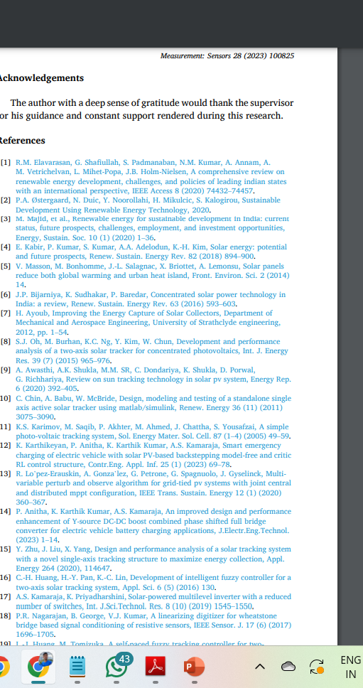

Slide 13
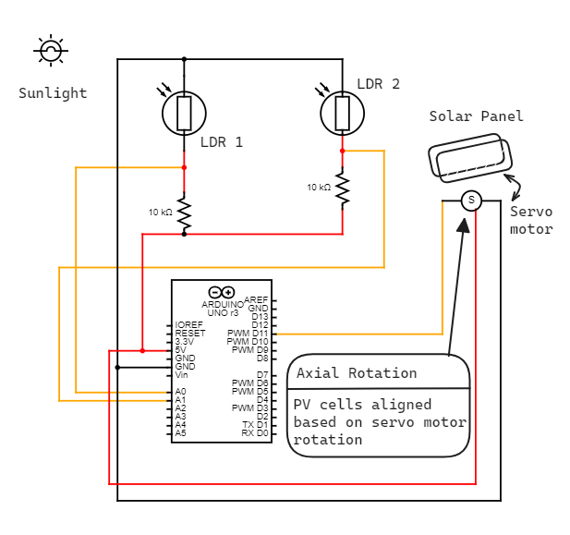
Architecture/Circuit level Diagram

Slide 14
Purpose & Requirements Specification
• Purpose: Implementing a solar panel tracking system to optimize energy generation by automatically adjusting the panel's orientation based on sunlight intensity.
• Behavior: The system detects changes in sunlight intensity using two Light Dependent Resistors (LDRs) mounted on the solar panel. It rotates the panel using a single-axis servo motor to maximize sunlight exposure throughout the day.
• System Management: The system provides automatic method of remote monitoring and control capabilities, allowing program to check the status of the solar panel and adjust its orientation as needed.
• Application Deployment: The control interface for the solar panel tracking system is not deployed on the web. Instead, it is designed to operate locally

Slide 15
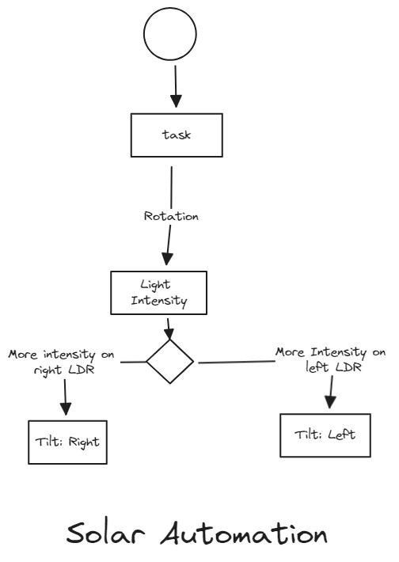
Process Specification

Slide 16
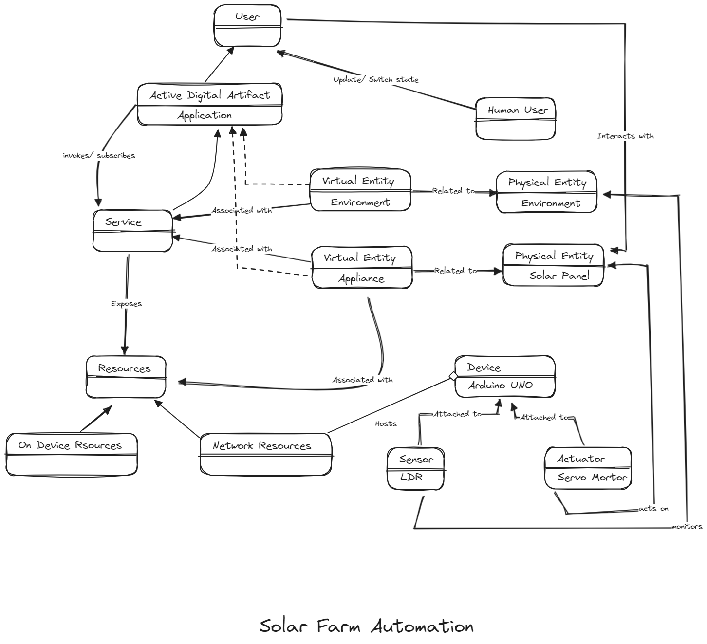
Domain Model

Slide 17
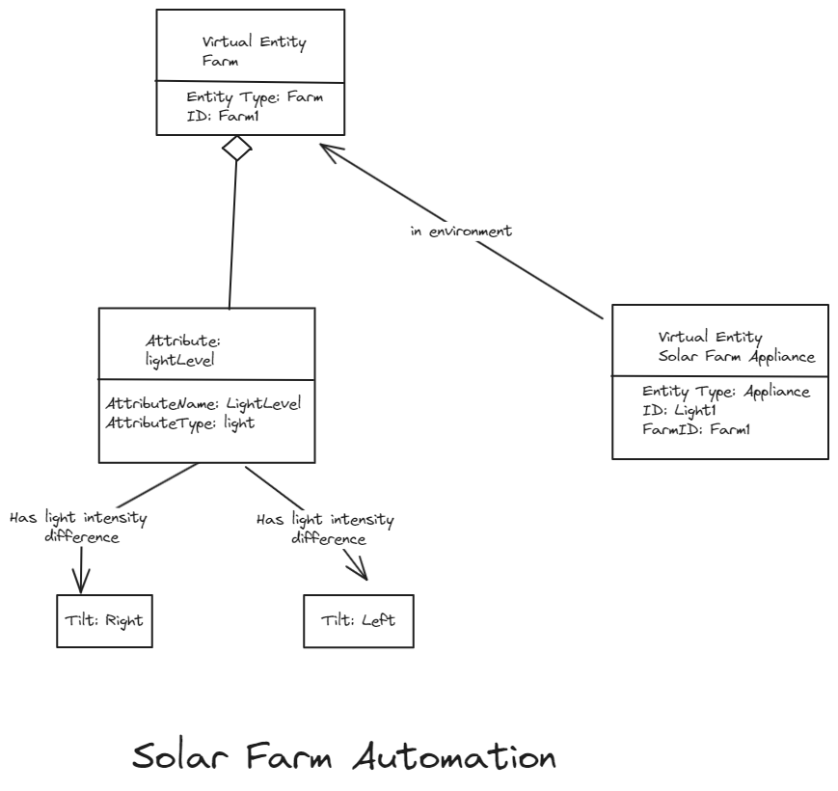
Information Model Specification

Slide 18
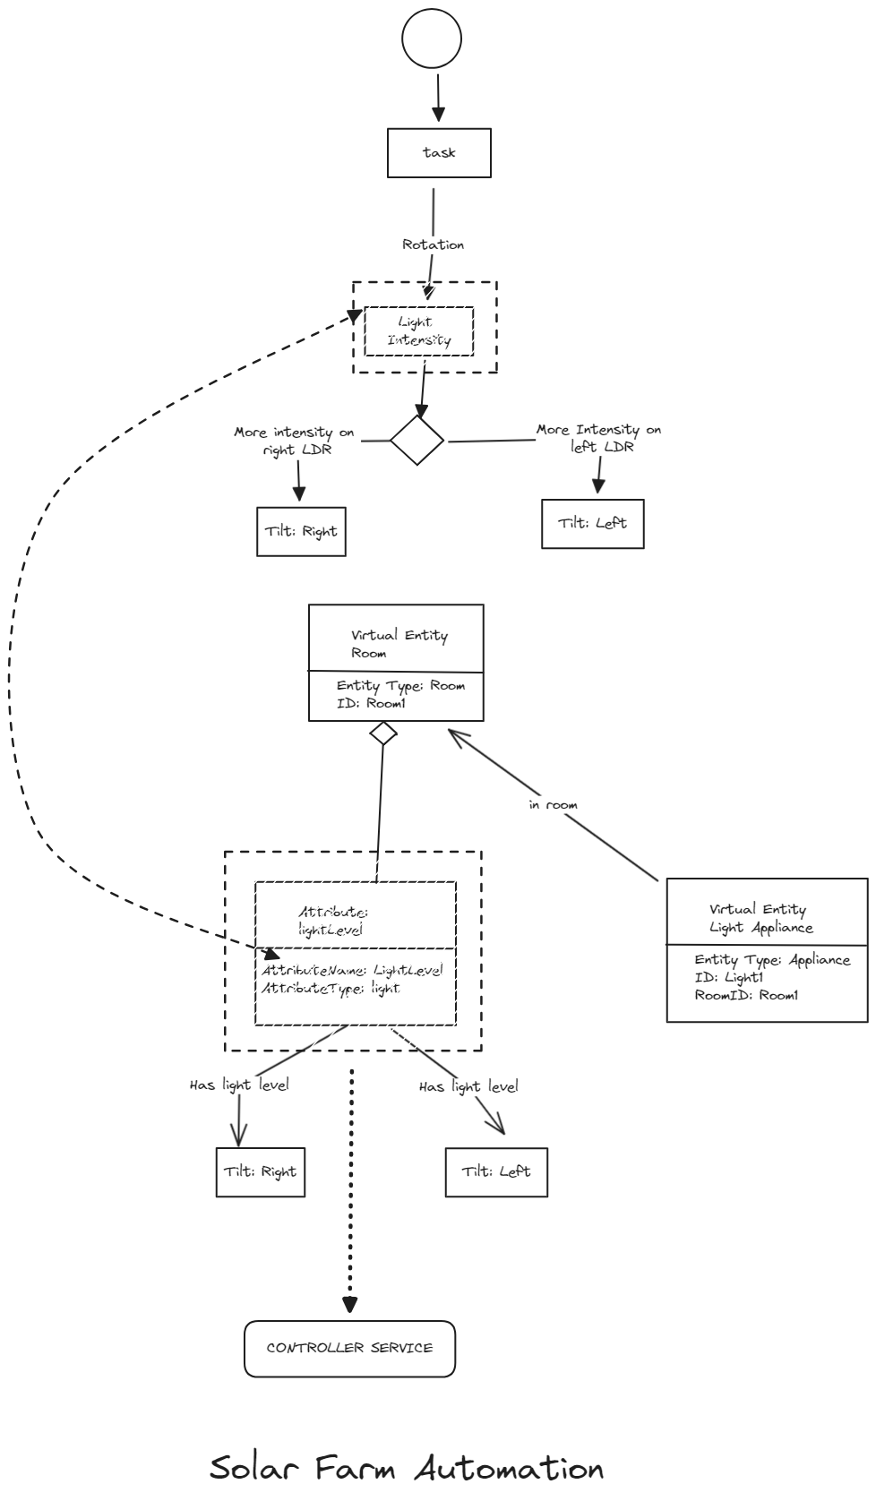
Service Specifications

Slide 19
Methodology
Solar panel tracking system that utilizes LDR sensors and a single-axis servo motor to maximize sunlight exposure and optimize energy generation.

Slide 20
Materials Required
Single-axis servo motor
Two LDR sensors (also known as photocells or light sensors)
Arduino or similar microcontroller board
Breadboard and jumper wires
Solar panel
Mounting hardware for the solar panel and servo motor
Power supply for the Arduino and servo motor
Jumper wires as required.

Slide 21
Mount the Components
Attach the LDR sensors to the edges of the solar panel, ensuring they are facing upwards to detect sunlight.
Mount the servo motor securely to the solar panel frame or mounting structure.

Slide 22
Connect Components
Connect the LDR sensors to the analog input pins of the Arduino.
Connect the servo motor to the digital output pins of the Arduino.

Slide 23
Code the Arduino
Write a program in the Arduino IDE (Integrated Development Environment) that reads the analog values from the LDR sensors and controls the servo motor accordingly.
Use the inbuilt functions to read the values from the LDR sensors.
Calculate the intensity difference between the two LDR sensors by subtracting one sensor's reading from the other.
Map the intensity difference to a servo motor angle range (e.g., 0 to 180 degrees).
Use the Servo library to control the servo motor and set its position based on the calculated angle.

Slide 24
Calibrate the System
Testing of the system under different lighting conditions to ensure the servo motor responds appropriately to changes in sunlight intensity.
Adjusting of the code or sensor positions if necessary to improve accuracy and responsiveness.
Notes:
Microgrids are designed to operate independently in the event of a power outage
Hierarchical control: Based upon the difference in time scales of various control requirements
Tertiary control: Regulates power flow by adjusting voltage amplitude and frequency while coordinating the operation of several MGs

Slide 25
Implement Power Management
Ensuring that the system is powered adequately to operate the Arduino, servo motor, and sensors continuously.
The use of a rechargeable battery pack or connecting the system to a solar power source for sustainable operation.

Slide 26
Test and Optimize
Test the system over an extended period to verify its reliability and performance.
Monitor the solar panel's orientation and adjust the code or hardware as needed to optimize energy collection efficiency.

Slide 27
Thank You

